Slide 1

.
B.Tech External Project Evaluation, VIIIth Sem
Project Title - ARIMA Model for Delhi Air Quality Prediction with Health Advisory
Presented by :-
Sparsh Singh, 2019005921
Zaid Ahmed, 2019006065
Vidit Kumar, 20199568217
Under the Supervision of:-
.
Ms Kajol Mittal
Sharda University, Gr. Noida
DEPARTMENT OF COMPUTER SCIENCE & ENGINEERING
SCHOOL OF ENGINEERING AND TECHNOLOGY
August, 2023
1

Slide 2
Contents of the Presentation:
Introduction to the project
Problem Statement
Hardware & Software Specification
Workflow
Models
Observations
Results and Outputs

Slide 3
Introduction to the Project
Air quality forecasting that uses predictive models has the potential to help people and the environment cope with periods of high pollution .The Air Quality Index (AQI) is a number used by governmental agencies to characterize the quality of the air at a given location. AQI is used for local and regional air quality management in many metropolitan cities of the world . The improvement of air quality projections is therefore one of society's most essential aims.
This work presents the analysis of such pollutants and to predict them using the Auto Regressive Integrated Moving Average (ARIMA) model. We have also compared SARIMAX with two different models : Prophet, and LSTM The same quantity of parameter calibration was applied to all the models. The data set used in this model contains of various pollutants values observed on a specific date in a particular location. It is an efficient way by which we can find out whether the values of the pollutants are exceeding the limits prescribed by the World Health Organization (WHO).
.

Slide 4
Problem Statement
Air pollution is a severe problem in Delhi, India, causing significant health risks to its residents. The city's air quality is affected by various factors, including traffic congestion, industrial activities, and natural phenomena such as dust storms. Monitoring and forecasting air quality levels is crucial to mitigate the harmful effects of air pollution on human health and the environment. Traditional methods for air quality forecasting have limitations in accuracy, reliability, and timeliness, making it necessary to explore advanced techniques such as machine learning and deep learning.
The problem is to develop accurate and reliable models for air quality forecasting in Delhi using time series data. The models should provide real-time air quality forecasts that are accessible to policymakers, researchers, and citizens. The goal is to help mitigate the harmful effects of air pollution on human health and the environment by providing timely and accurate information about the air quality levels in Delhi.

Slide 5
Hardware & Software Specification
Hardware Requirements:
A powerful CPU with multiple cores to handle the computation-intensive machine learning models
Sufficient RAM to store the data and run the models effectively
Sufficient storage space to store the large datasets and the trained machine learning models
An internet connection to access the required data and resources
Software Requirements:
Python programming language with relevant packages such as Pandas, NumPy, Matplotlib, Scikit-Learn, Keras and Prophet for data manipulation, visualization, and machine learning.
Python: The project requires Python programming language to be installed, preferably Python 3.7 or higher.
Integrated Development Environment (IDE): The project can be developed using an IDE like Visual Studio Code or any other IDE of your choice.
Operating systems such as Windows or Linux, depending on the preference of the developer.

Slide 6
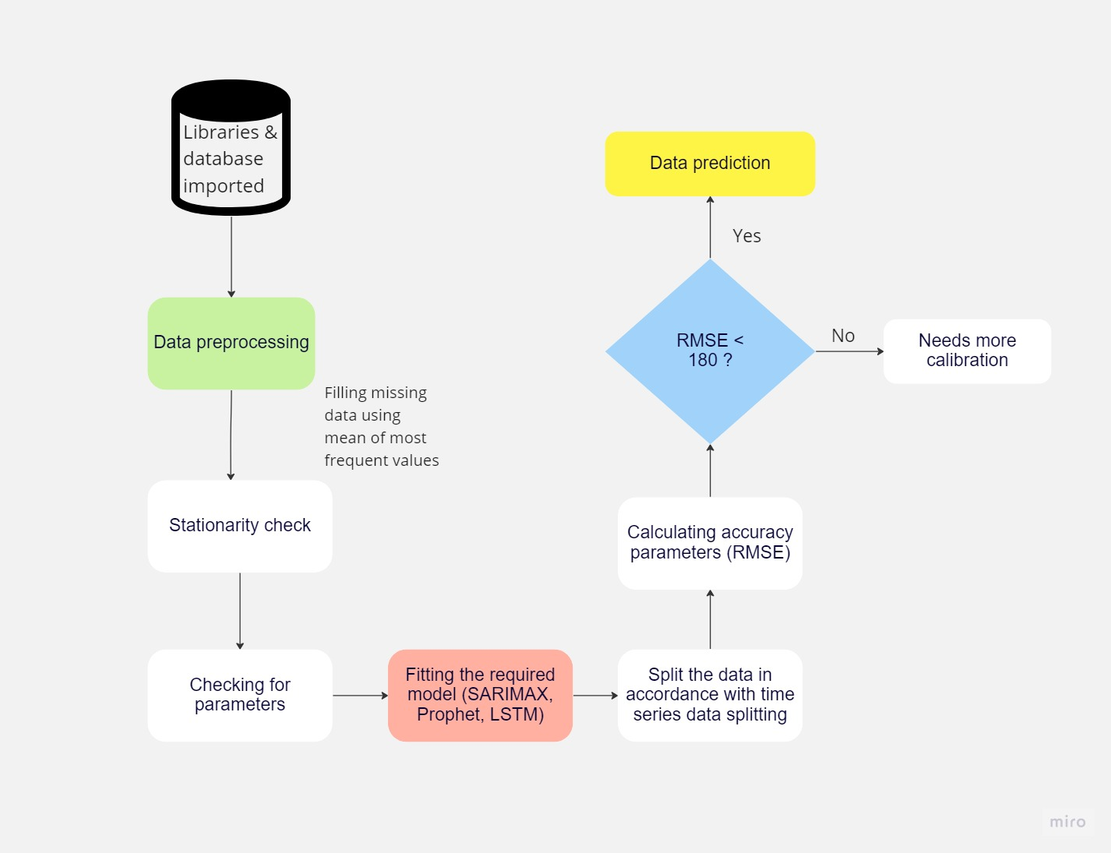
Workflow

Slide 7
MODELS
SARIMAX
SARIMAX (Seasonal Autoregressive Integrated Moving Average with exogenous variables) is a statistical time series forecasting method that extends the ARIMA (Autoregressive Integrated Moving Average) model to include seasonal components and exogenous variables.
SARIMAX can be useful in forecasting time series data with both trend and seasonal patterns, as well as incorporating the effects of external variables. It has been applied in various fields, such as finance, economics, and environmental studies, for predicting stock prices, GDP, and air pollution levels, among other things.

Slide 8
PROPHET
Prophet is a time series forecasting tool developed by Facebook's Core Data Science team. It is an open-source tool that utilizes a decomposable time series model with three main components: trend, seasonality, and holidays. Prophet's strengths lie in its simplicity and ease of use, as well as its ability to produce accurate forecasts quickly, even with limited data. It can also handle non-linear trends and seasonality, and automatically adjusts for changes in trend and seasonality over time.
Prophet has been applied in various fields, including finance, retail, and weather forecasting, and is particularly useful in predicting time series data with short-term fluctuations and multiple seasonalities.

Slide 9
LSTM
LSTM (Long Short-Term Memory) is a type of recurrent neural network (RNN) that is widely used for time series forecasting. It is designed to overcome the limitations of traditional RNNs, which struggle to capture long-term dependencies due to the vanishing gradient problem.
LSTMs use a series of memory cells that allow them to selectively forget or remember information over time. They are able to learn patterns and relationships in sequential data, and can predict future values based on past observations. LSTMs are particularly useful in time series forecasting as they can handle both linear and nonlinear relationships, and can capture complex patterns in the data such as seasonality, trends, and sudden changes. LSTMs have been successfully applied in various fields, including finance, weather forecasting, and energy load forecasting.

Slide 10
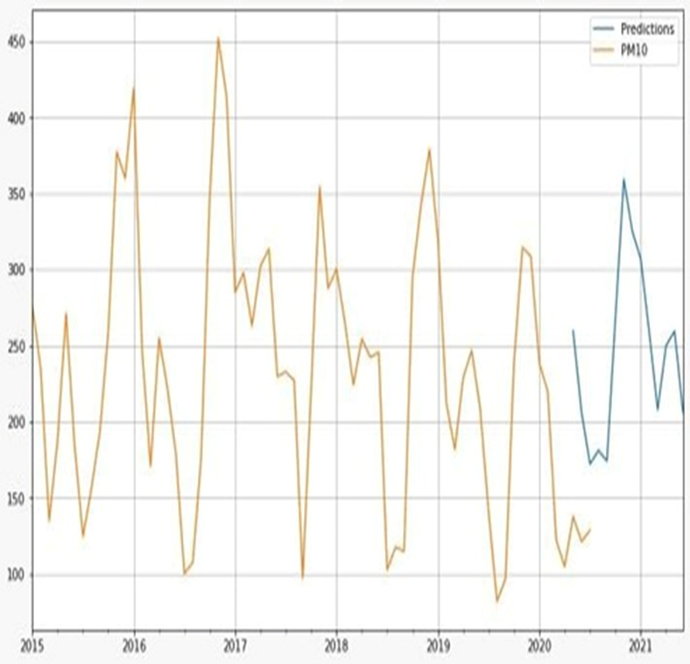
Observations
Some observations that can be derived from the given visualization:
PM10 concentration levels spike by the end of every year
Reasons that due to which these spike levels are seen can be due to festivity season, crop burning, etc.

Slide 11
RESULTS AND OUTPUTS
Evaluation Metrics
After implementation we can compare the performance values of these models using RMSE which stands for Root Mean Squared Error. The root mean squared error is a type of error measurement that calculates the square of the deviations to prevent the positive and negative deviations from offsetting each other. This approach can magnify significant errors, making it useful for comparing different methods.
Model | RMSE | Pollutant
SARIMAX | 39.106712968850374 | PM10
Prophet | 18.533817246102544 | PM10
LSTM | 28.9867676267148 | PM10

Slide 12
RESULTS AND OUTPUTS
From the experiments performed above it can be concluded that in our case of univariate time series forecasting, Prophet model performed better than its competitors here.
If the LSTM model's Root Mean Squared Error (RMSE) score is not as expected, it may be beneficial to try training the model for additional epochs. By continuing to train the model, it may be able to capture more of the necessary time series-related information and result in a lower loss.
In order to ensure the accuracy and effectiveness of the best models, they should be examined and assessed using various datasets. With the SARIMAX model, the computational constraints and continuity of data degraded the performance of the model .SARIMAX could be enhanced by adjusting its parameters to improve its performance. Additionally, it would be beneficial to expand the scope of the study beyond just Delhi and capture the air pollution levels in other locations as well.

Slide 13

GitHub Repo
https://github.com/SPSingh3000/time-series-weather

Slide 14
THANK YOU

